Slide 1
Deadlock
CEG 4131 Computer Architecture III
Miodrag Bolic
Notes:
Notes by Patrick Santos (4465359)

Slide 2
Overview
Channel collision resolution
Virtual channels
Deadlock deﬁnitions
Resource dependencies
Acyclic deadlock free routing techniques
Virtual channels and acyclic deadlock free routing techniques

Slide 3
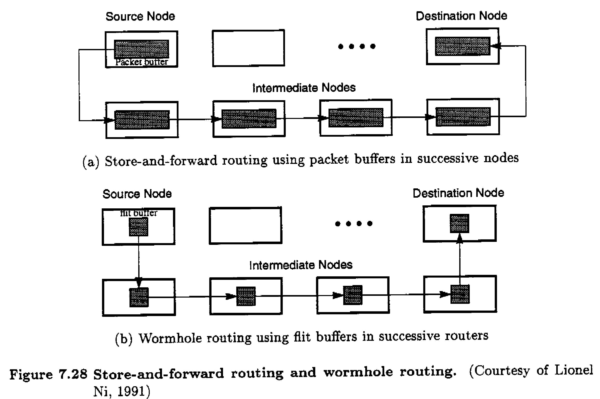
Review [4]
Notes:
3 Review
In this figure, two different routing mechanisms, store-and-forward, and wormhole routing, are reviewed and compared.
In store-and-forward routing, the entire packet must be buffered in a node before being sent to the next node. This requires a large buffer in each node (to store each individual packet), but blocking can only occur on one pair of nodes at a time with respect to deadlocks. A deadlock can occur in a network based on store-and-forward routing if a set of nodes with full buffers are waiting on each other, resulting in circular waiting [1].
In wormhole routing, packets are divided into pieces known as flits, and a node may transmit a flit to the next node in a network as soon as it has buffered that flit (rather than having to buffer the entire packet) [2]. Smaller buffers may be used within routers (as they do not have to store entire packets), but more routers can be blocked at a time, since a single packet can fill the buffer of multiple routers.
For store-and-forward routing, the latency T = (D+1)(L/W)
For wormhole routing, the latency T = (L/W) + (F/W)(D)
Where: D is the distance, or number of hops; F is the flit length; L is the packet
length; W is the channel bandwidth

Slide 4
Packet Collision Resolution [3]
To move a flit b/t adjacent nodes must have:
  Source buffer holding flit
  Channel being allocated
  Receiver buffer accepting flit
Arbitration decisions
  Which packet will be allocated the channel
  What to do with rejected packet
Notes:
To move a flit between two adjacent nodes, there must be a buffer holding the flit in the source router, a channel allocated for the transmission of the flit, and an available buffer to accept the flit at the receiving router. Note that the source and receiver are not necessarily the source and destination of the packet. In this case, the source and receiver may be intermediate nodes between the source and destination of the packet which the flits belong to.
Arbitration between the routers, either by a centralized arbiter or distributed arbiters is required. Arbitration schemes depend on what kind of network and routing is being used. For virtual channel routing, arbitration is required to determine which packet a channel will be allocated to, if multiple packets are waiting in a queue. In another case, if packets are rejected instead of blocked, what is to be done with a rejected packet.

Slide 5
Buffering with Virtual Cut-Through Routing [3]
Rejected packet temporarily stored in buffer
Requires large buffer to hold entire packet
Does not waste allocated resources
Best case: wormhole routing
Worst case: store-and-forward
Notes:
Virtual Cut-Through routing is a technique that buffers entire packets, while still able to pipeline a transmission across several routers [3]. Like store-and-forward, it requires buffers with the capacity to store an entire packet, but it will only use these buffers to store packets if the packet is blocked. This means that the virtual cut-through routing algorithm does not needlessly buffer the packet if it is not required to do so, avoiding a waste of resources. Therefore, it can achieve the performance of wormhole routing if the packet is not blocked, and in a worst-case scenario (where a packet is always being blocked at each intermediate node), it will have performance similar to store-and-forward, as the packet gets buffered in its entirety before being sent to the next node (after the blocking router is free).

Slide 6
Blocking and Detour Policies [3]
Blocking: block rejected packet, do not abandon
  Economical, idle resources
Discard: drops blocked packed
  Waste of resources
Detour: misroute to a detour channel
  Flexible, but wastes channel resources, may cause cycle of livelock
Notes:
If a packet cannot pass to the next node because the next node is busy processing another packet, the packet can be blocked, discarded, or rerouted, depending on the routing algorithm. Blocking uses the least resources in terms of processing since a packet does not need to take a longer route or be retransmitted altogether. Blocking packets during transmission can cause deadlocks if a circular waiting pattern is established. Packets can also be discarded or dropped, which means that the packet does not reach the destination and the source must retransmit. Although it is simple to discard a packet, there is a waste of resources since the source must retransmit, and the same information must be propagated through the network again. Another more complex alternative is to reroute the packet, in which the routing algorithm chooses another free node to transmit the packet to, in an attempt to get that packet to the destination. This method may waste resources in the network since packets may be sent using non-optimal paths, and a livelock may occur, where packets are travelling around the network in circles with no way to reach the destination.

Slide 7
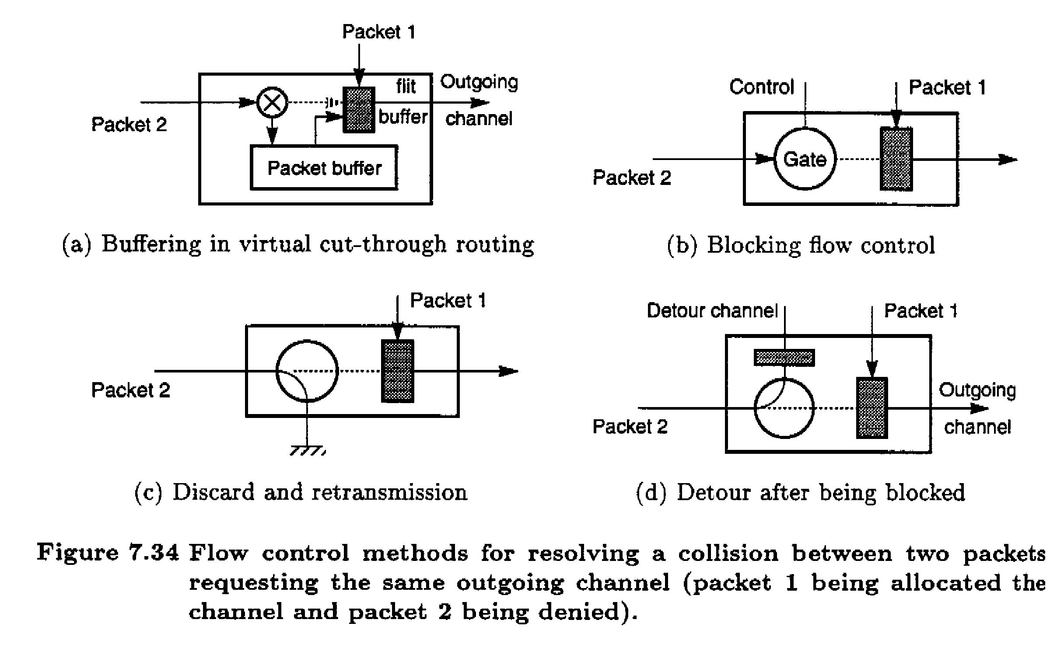
From [4]
Notes:
7 Blocking and Detour Policies (image)
The following figure shows the different blocking and detour policies. In subfigures (a) and (b), methods of blocking are shown. Subfigures (c) and (d) show discard and rerouting of a packet in the case of a collision. In (a), with virtual cut-through, the blocked packet 2 is sent to a temporary buffer, and is to be transmitted after the router is done with packet 1. In (b), the gate blocks the previous router from sending packet 2, and continues blocking until it has processed packet 1. In (c), the router discards packet 2 since it was not finished with packet 1, forcing the source of packet 2 to retransmit. In (d), packet 2 is sent to another channel, potentially sending it to the destination using another route.

Slide 8
Buffer management and backpressure [1]
Inform the nodes to stop transmitting because all the flit buffers are full.
Methods
  Credit based
  On/Off
  Acknowledgement algorithms
Notes:
There are various methods to implement blocking in the case where a router is busy and cannot process or buffer additional packets. Each method is a way to tell the previous node to stop transmitting. The methods are a credit based, on/off, and acknowledgment algorithms.

Slide 9
Credit based flow control [1]
The upstream router keeps a count of the number of free flit buffers in each channel.
If the count reaches zero, all the downstream buffers are full.
Notes:
In credit-based flow control, the router keeps a tally or number of “credits”' of free flit or packet buffers are kept to inform adjacent routers if they can continue to transmit to that router. If this number of credits is zero, this is a signal that the router's flit buffers are full and packets cannot be transmitted to that particular router until it is done processing previous packets. Each time a router successfully processes a flit, it increments the number of available credits, and likewise, it decrements the number of available credits when it receives a packet. This method generates additional traffic, since a receiver must always let the sender know how many credits are left. If a packet is sent through multiple routers, signals of credit counts being updated must be sent across all the nodes of a packet's path. Credit-based flow control is used for routers with smaller buffers.

Slide 10
Virtual Channels [3]
A logical link b/t two nodes, formed by a flit buffer in source, a physical channel b/t them, and a flit buffer in receiver
Physical channel is time-shared by virtual channels
Sharing of physical channel by set of virtual channels is conducted by time-multiplexing on a flit-by-flit basis
Notes:
Virtual channels are a logical link between nodes, which is maintained by having multiple flit buffers which are used share a single physical channel. The physical channel is time-shared between the virtual channels by the use of multiplexers. These multiplexers switch between the different flit buffers in a router. It will process the flit in one buffer, then switch to another buffer in the next time instance. This switching of a single physical channel between the different flit buffers behaves like several slower channels (if more the router is handling more flits than it has physical channels at the time).
(Note that time instances are not necessarily the same as clock cycles, and are likely longer than one clock cycle.)

Slide 11
Virtual channels [1]
Virtual Channel Implementation
  Separate buffers for each virtual channel
Virtual Channel Key Feature
  A message blocked in one virtual channel does not prevent message in any other virtual channel from using link
Analogy- left turn to the congested side road
Notes:
As noted in the previous slide, the router maintains separate flit buffers for each virtual channel it can use. An important note about virtual channels is that if a flit from one of the virtual channels is blocked, the entire router is not necessarily blocked. The router can switch to other non-blocked channels and process those channels until the situation that caused the blocking is gone.
This is similar to an intersection with turning lanes on the road. Vehicles go to dedicated turning lanes where they can wait to turn. If the path a vehicle must take to turn is blocked, vehicles going straight can still go straight, since the vehicles that are turning are on a different lane.

Slide 12
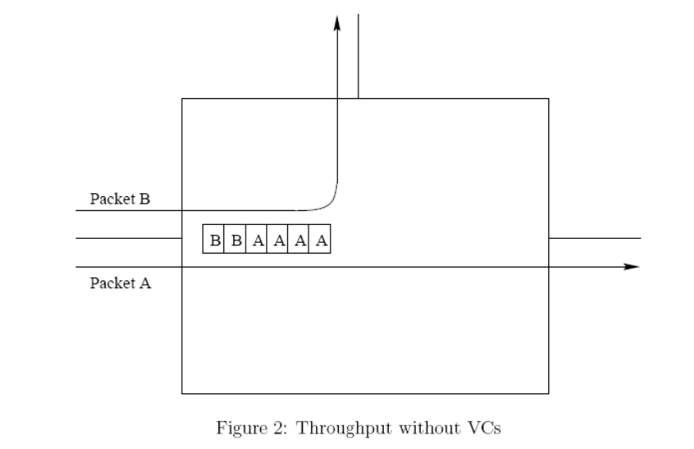
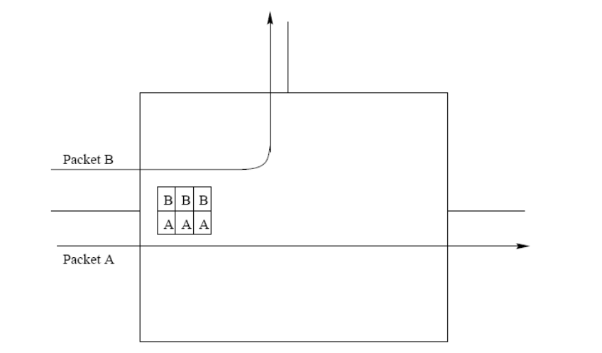
Routing messages through VC [1]
Notes:
The following figures show the routing of messages without virtual channels (left), and with virtual channels (right). This scenario can happen if packets A and B are attempted to be sent through the router at almost the same time, but with A arriving at the router a small amount of time before B. In the example without virtual channels, packet A is processed completely before B (as B is blocked until the processing of A is complete). In the example with virtual channels, the handling of A and B is time-multiplexed, as the router handles a flit of A, then a flit of B, until both packets have been processed. The virtual channel prevents packet B from being blocked, but since both A and B are being received through the same physical channel, they can only be processed at half of the full bandwidth of the network (as the time multiplexing at the router bottlenecks the transmission). This is one of the disadvantages of the virtual channel, since any use of the multiplexing will reduce the transmission speed of the packet all the way to the destination.

Slide 13
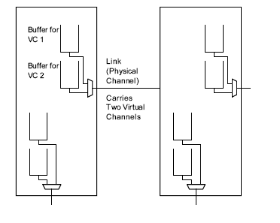
Virtual Channel Implementation [1]
Notes:
The following figure shows an implementation of virtual channels, where buffers are used to create two virtual channels on one physical link. The multiplexer switches between the two channels allowing it to process two packets at once on the physical link. There is a multiplexer at each of the ``directions'' the router can use to transmit a packet.

Slide 14
Virtual channels and wormhole flow control [1]
Notes:
???

Slide 15
Deadlock [2]
Deadlock
  Occurs in interconnection network when group of agents (e.g. packets) are unable to act because of waiting each other to release some resource (e.g. channels or buffers)
  May be prevented using
  Deadlock avoidance – something that guarantees that deadlock won’t happen
  Deadlock recovery – mechanism or deadlock detection and recovery
Livelock
  Packets continue to move through network, but do not advance towards destination
  May appear when non-minimal routes are allowed
Notes:
A deadlock can occur in an interconnection network if a set of routers or packets are waiting on each other to free resources, but the resources cannot be freed due since they are waiting in some circular waiting pattern. A deadlock can be prevented using deadlock avoidance or deadlock recovery. Deadlock avoidance is a strategy in which the routing algorithm is set up in such a way to not have a deadlock. Deadlock recovery allows deadlocks to occur, but has a mechanism to detect and then resolve deadlocks.
Deadlock prevention algorithms or deadlock-free mechanisms require additional virtual channels to be available to make deadlocks impossible, or may choose non-optimal paths in order to avoid deadlocks. Deadlock prevention algorithms on the other hand, require less buffers (usually a buffer used to free resources in the case of a deadlock), but have been shown to have reduced throughput [4].

Slide 16
Deadlock [2]
What causes deadlock?
  Cyclic resources dependency.
Resources are:
  Wormhole routing: channels.
  Store and forward: buffers
  or virtual cut-through: buffers
Notes:
A deadlock is caused by a cyclic dependency, or circular waiting which can be shown by graphic resources and dependencies. The resources and dependencies that cause deadlocks in interconnection networks depend on the type of network. For wormhole routing, channels (physical or virtual) are blocked when a message is passing between nodes, so a circular pattern of blocked channels will cause a deadlock. For store-and-forward or virtual cut-through routing, a buffer is used to blocked store packets. If routers with full buffers are blocking each other, a deadlock occurs.

Slide 17
Graphs [2]
Dependence Graph
  Used for analyzing deadlock.
  A dependence graph consists of a vertex for each resource and directed edge from vertex to B if is dependent on B.
Network Dependence Graph
  Vertices are (usually) links.
  Links to processors are sometimes included.
Notes:
Dependence graphs are used to analyse deadlocks, or the possibility of deadlocks. In a dependence graph, each resource (in interconnection networks these are channels and buffers) is represented by a vertex, and edges represent dependencies. The edges are directed, so for example, if B depends on A, the edge goes from A to B. A deadlock can occur if there is be a cycle in the dependence graph.

Slide 18
Deadlock avoidance [2]
Deadlocks can be avoided by eliminating cycles in resource dependency graph
  Imposing partial order over resources and designing agents to allocate resources in ascending order
Resource classes
  Divide resources into several classes and restrict allocation of resources within class to ascending order
  Dateline classes in ring networks
  Can be used to order resources in any topology
  Require amount of resources proportional to diameter of the network
Notes:
Deadlock avoidance (or a deadlock-free algorithm) is one where there can be no cycles in the dependency graph. Methods for deadlock avoidance include resource classes, restricted physical routes, dimension-order routing, and a turn model.
Resource classes break the resources in a network into groups (classes) which are designed to not have a cyclic dependency. In addition to not having a cyclic dependency inside a class, classes are divided by a hierarchy, in which a member of a class can only access a member of a higher class, and not a lower one. An example of resource classes is the dateline classes used in ring, or torus networks in the Cray T3E [5]. Each virtual channel in a router is placed into an ascending hierarchy of classes, and if a message needs to go through a certain node in the network, called the ``dateline node'', it much use virtual channels in the next highest class. For example, if a message is sent through virtual channel 0, it must use virtual channel 1, the next higher channel if it needs to go around the entire network. A deadlock cannot occur because the dateline node breaks any potential cycles in the dependency graph. This method requires additional resources as the diameter of the network increases.

Slide 19
Deadlock avoidance [2]
Restricted physical routes
Dimension-order routing
  Restrictions are applied for routing in specific dimensions
  These restrictions are used to enumerate channels in the network
  Enumerated channels are allocated in ascending order, it saves network from the deadlock
Turn model
  Restrictions are applied for making turns in particular direction during routing
  These restrictions are used to enumerate channels in the network
Notes:
Restricted physical routes, dimension-order routing, and turn model routing all rely on some geometric property to prevent deadlocks. Dimension-order routing constrains how a packet can be routed in a multi-dimensional network. This method prevents deadlock in a packet which passes between dimensions in a multi-dimensional network, by placing a restriction such as using channels in dimension x, then using channels in dimension y (without being able to go back to the x-dimension) [6]. The cycle of going to a node in dimension x, then y, then back to x is therefore broken. Turn-based routing eliminates cycles by restricting which changes of direction a packet can make as it goes to the destination. One model is XY routing, in which a packet must travel in the x-direction, then in the y-direction. XY routing and other turn-based routing techniques forbid combinations of turns packets in transmission can make to avoid cycles [4].

Slide 20
Deadlock recovery [2]
Avoiding deadlocks requires additional resources/performance from the network
  Instead of avoiding deadlocks it is possible to detect and recover it
Detection of deadlock
  In general case is resource-consuming search of cycle in resource wait-for graph
  Conservative algorithms always identify a deadlock right, but may cause false alarms
  Timeout counters
Notes:
Other techniques detect and allow the system to have deadlocks and recover from them, instead of trying to avoid deadlocks. Deadlocks are detected in the system using resource-consuming tasks such as searching for a cycle, or using timers which signal a potential deadlock if they expire. Some of these algorithms cause false alarms if not used properly. For example, if timeout thresholds on timers are not properly chosen, the system may assume a deadlock when a packet is simply being delayed [4].

Slide 21
Deadlock recovery [2]
Regressive recovery
  Deadlocked agents (e.g. packets) are removed from network
  Timer starts when first flit of packet is injected into network
  If timer reaches threshold before last flit is injected, then packet is removed
  Otherwise packet’s head is guaranteed to reach destination
  Packet must be long enough to allocate all channels (resources) from source to destination
Progressive recovery
  Resolves deadlock without removing packets from the network
  Uses deadlock-free adaptive routing
Notes:
If a deadlock recovery algorithm detects a (probable) deadlock, it can perform regressive or progressive recovery. With regressive recovery, packets which are suspected to be involved in the deadlock are removed from the network. One such algorithm starts a timer when the first flit of a packet enters the network, and stops when the last flit enters into the network. A deadlock is assumed and the packet is removed from the network if the timer times out before the last flit of the packet enters the network. If a regressive algorithm removes a packet, the packet must then be retransmitted or reinserted into the network at a later time, increasing the amount of traffic [7]. Progressive recovery reroutes deadlocked packets instead of discarding them. This can be done by rerouting packets involved in deadlocks into another higher priority ``recovery path'' that contains no deadlock [7]. A possible recovery path can be constructed by having deadlocked packets pre-empt other traffic on their way to the destination to free the network of the deadlock.

Slide 22
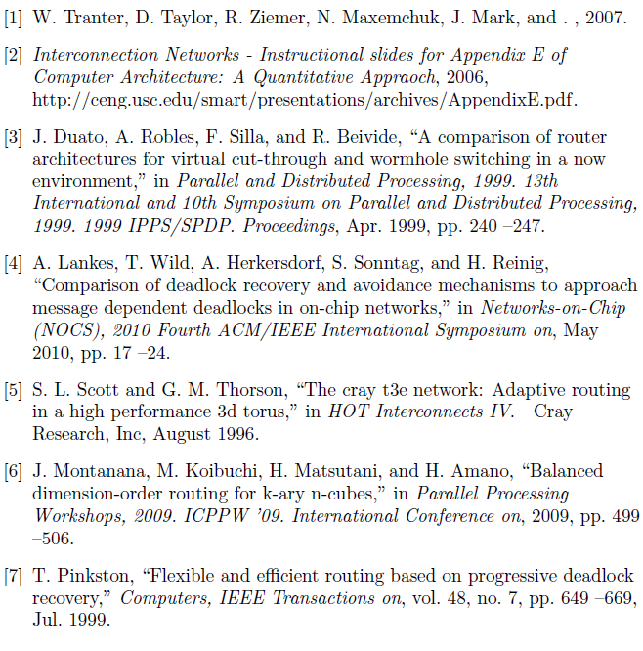
References
W.J. Dally and B.P.Towles, Principles and Practices of Interconnection Networks, Morgan Kaufmann, 2003.
Eugene Zemskov, Deadlock and Livelock, presentation, Tampere University of Technology, http://www.tkt.cs.tut.fi/kurssit/9636/K05/Chapters14-15.pdf
A. Bourgeois, Advanced Computer Architecture, lecture slides, Department of Computer Science at Georgia State University
K. Hwang, Advanced Computer Architecture Parallelism, Scalability, Programmability, McGraw-Hill 1993.
Notes:
Added references copy-pasted to the side of the slide off-screen as copying the references page out of the PDF caused many formatting errors that looked like spelling mistakes.

